Slide 1
CLEAN WATER CONSTRUCTION COALITION FLY-IN / BUSINESS MEETING
April 25, 2023
11:00 am EST
VIA TEAMS Platform

Slide 2
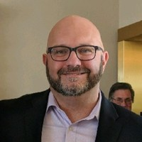
WELCOME & AGENDA OVERVIEW
WELCOME AND PARTICIPATING MEMBER RECOGNITION
HOUSEKEEPING
FEEL FREE TO ENTER QUESTIONS / REQUESTS TO COMMENT IN CHAT BOX
YOU WILL BE CALLED ON IN ORDER, PLEASE UNMUTE AND CONTRIBUTE THEN GO BACK ON MUTE
WE ARE RECORDING
AGENDA OVERVIEW
Dan Kennedy, Sr. Director UTCA of NJ

Slide 3
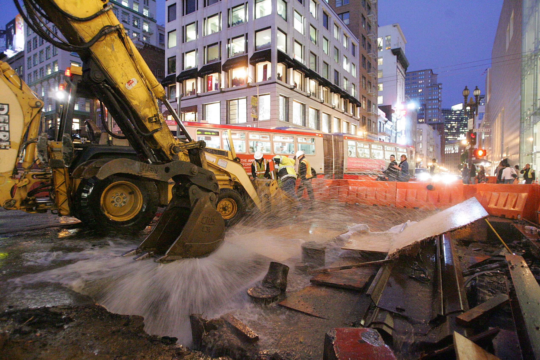
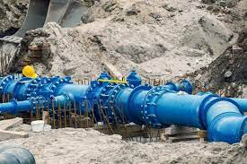
CWCC MISSION: The mission of the Clean Water Construction Coalition is to promote federal actions that increase funding and accelerate project delivery for water infrastructure and related projects.

Slide 4
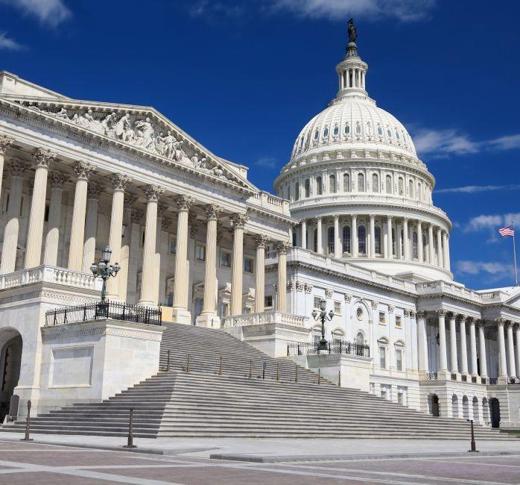
ADVOCACY UPDATE
Sante Esposito,
Key Advocates Inc.
CWCC Lobbyist

Slide 5
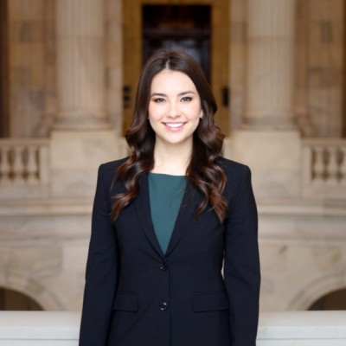
HILL UPDATE
*INVITED*
Marisa Silva, Economic Development & Strategic Initiatives Director for Senator Martin Heinrich (D-NM), a member of the Appropriations Committee.

Slide 6
RECOMMENDED ADVOCACY “TONE” –
We should ensure that commitments for robust funding for programs of interest to the Coalition are met and expanded. Focus on alternative funding sources for “EARMARKS.”
Growth of water infrastructure needs faced by our states are outpacing increases in funding. This is in addition to construction industry realities (material costs, for example) driving up project costs resulting in dollars not going as far in the field..
We should bring attention to State-lead decisions on discretionary federal funding (American Rescue Plan $) being directed to water infrastructure
We should be setting the stage for members to help push state leaders if / when projects are slow to market. They have a vested interest in funding translating into opportunity for our members.
We should reinforce that we are NOT at “MISSION ACCOMPLISHED” stage
BOTTOM LINE - More funding means more projects and more projects mean more jobs.

Slide 7
Why the SRFs? SRFs are state-run programs that have a national impact on the U.S. economy.
SRFs are the nation’s premier programs for financing water infrastructure that protects public health and the environment.
SRFs effectively and efficiently deliver federal funding for water infrastructure projects to hundreds of communities across the country.
SRF financing of water infrastructure creates high-wage jobs across the economy – from planning to engineering to construction.

Slide 8
CWCC 2022 Priorities
PRIORITY #1: Fully Fund Commitments (IIJA + Base FY Appropriation) and Increase Funding
Fund Drinking Water, Wastewater, Stormwater, Water Reuse Programs to IIJA levels + Base FY Appropriation Levels for FY24:
Clean Water SRF Funding at minimum of $4.58 Billion ($2.95 Billon IIJA + $1.63 Billion FY Base). In addition:
Drinking Water SRF Funding at minimum of $4.05 Billion ($2.95 Billion IIJA + $1.10 Billion FY Base)
Water Infrastructure Finance and Innovation Act (WIFIA), including State WIFIA (SWIFIA) at a minimum of $80 Million
If Congress chooses to continue the use of Congressionally Directed Spending (earmarks) for water infrastructure projects, these funds must be additive to the overall EPA budget and NOT come out of the baseline SRF funding moving forward; and
Inclusion of additional funding for the SRFs, Alternative Water Source Program and other water programs of interest in the final version if anything emerges from the “Build Back Better” framework; and
Enactment of Title XVI WIIN grant funding and Federal share increase.

Slide 9
CWCC 2022 Priorities
PRIORITY # 2: Accelerate the Work
Enactment of legislation, policies, regulations and specifications that accelerate the project pipeline and bring more water projects to construction in a timely manner. Advocate that EPA require State SRF’s to streamline review and approval processes for the replacement or improvement of existing water infrastructure assets.
PRIORITY #3: Price Escalation / Build America, Buy America Requirements
Recognize near-term challenges, such as inflation, disruptions to supply chains, and lack of domestic capacity or supply when implementing new domestic preference procurement requirements for construction materials and manufactured products. Protecting public health and the environment, while maintaining affordable user rates, requires the flexibility to source the most cost-effective materials and best available technologies.

Slide 12
ADVOCACY OPTIONS
BRIEFINGS IN-PERSON / IN-STATE or DC
REMOTE MEETINGS WITH DELEGATION / STAFFERS
“VOTER VOICE” TOOLS
PUT OUT BY ORGANIZATION – PARTICIPATION BY MEMBERS, ASSOCIATES, PARTNERS
STATEWIDE / LOCAL OP EDS
ORGANIZATIONS / PARTNERS
EARNED MEDIA
WATER WEEK TEMPLATE SAMPLE SOCIAL MEDIA POSTS – SHARABLE GRAPHICS
ORGANIZATIONS / MEMBERS
#CLEANWATERCONSTRUCTION
#WATERWEEK2023

Slide 13
CWCC BUSINESS
ACTIONS COMPLETED
WEBSITE REDESIGN
MISSION STATEMENT REFRESHED
EXPANDED PARTICIPATION
RESTRUCTED FEE FOR CONSULTING SERVICES
2023 ACTIONS PROPOSED
NEW MEMBER RECRUITMENT
Roundtable Discussion of Common Issues

Slide 14
CLEAN WATER CONSTRUCTION COALITION
THANK YOU!

